Slide 1
Power Automate your way to Cognitive Services
Ben Watt
www.datalineo.com

Slide 2
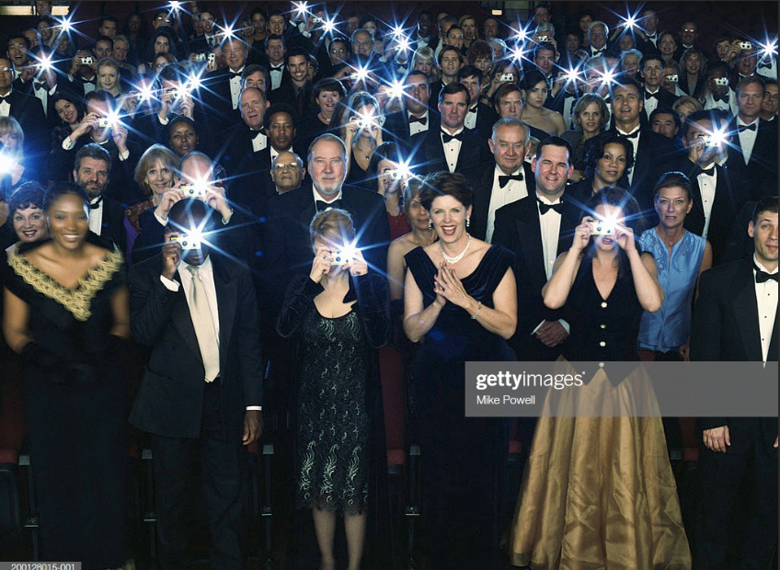
Send me your pics please
Email image@datalineo.com
Add some pictures to be analysed
Selfies
You & Friend
Random objects
New Pics or from your Gallery
No Politics Please ☺ !!
No photos or data is saved, shared, socialised
Everything is deleted later.

Slide 3

Agenda
Attendees: Send in your pics!
The Flow Process
Analytics in Power BI

Slide 4
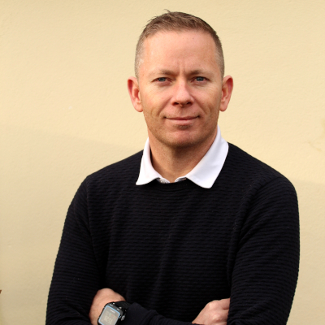




At your Service!
Managing Director at Datalineo
Microsoft MVP Data Platform
Power BI, SQL/Azure/Power Platform
Events & User Group
Dublin Power BI UG Leader
Microsoft Community Café
Data Ceili
Power Platform WT
SQL Saturday
Ben Watt
ben@datalineo.com
@benrebooted
linkedin.com/in/benonline

Slide 5













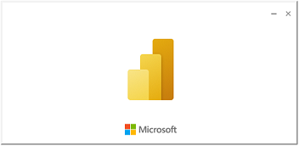
What does the Flow do?
Trigger
Actions
Power
Automate
Face API – Facial Attributes
For every attachment
Face API - Recognition
Store it in Azure Blob
Write to SQL
Email with images attached
Reply with Image Description(s)
Write to streaming dataset
Write to SQL
Delete Email
Computer Vision
Write to SQL
Power BI
Streaming Dashboard
Image Analytics Report

Slide 6

Done.
ben@datalineo.com
@benrebooted
linkedin.com/in/benonline
Demo content and slides here:
https://www.github.com/datalineo/sessions

